Slide 1
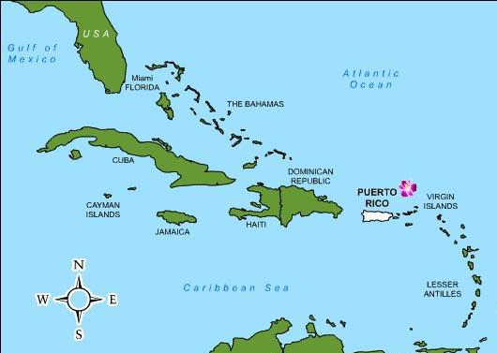
Solar United Neighbors Puerto Rico – Nuestra Señora del Carmen Resiliency Hub
1,000 miles southeast of Miami
David Ortiz, 3/14/24

Slide 2
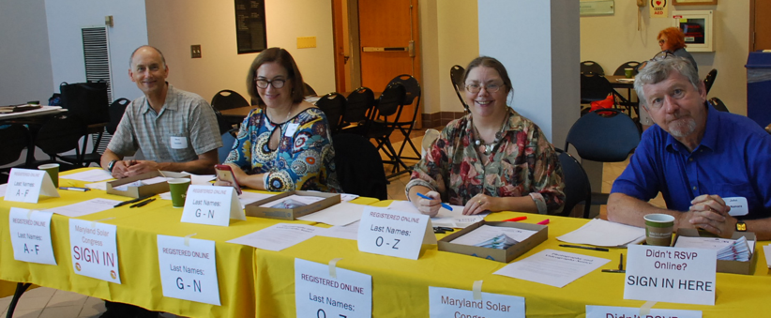
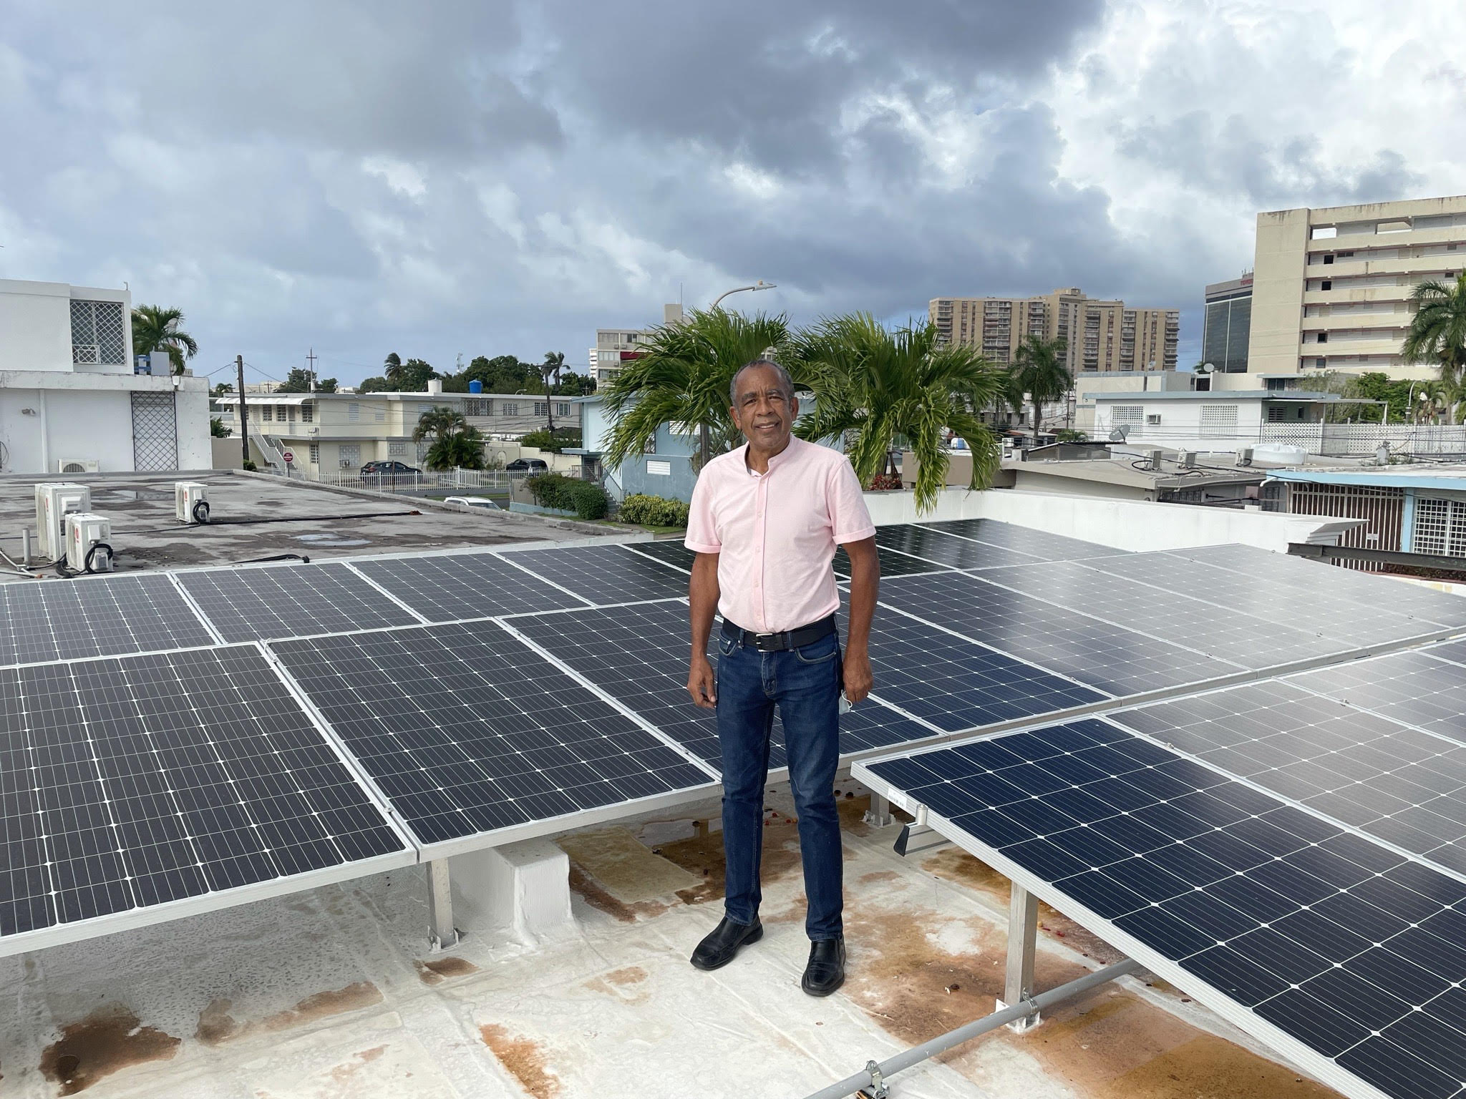
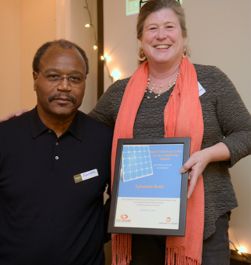
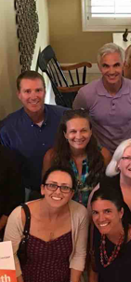
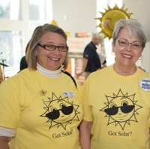
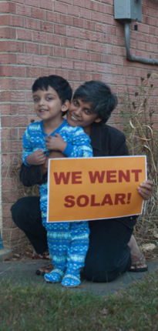
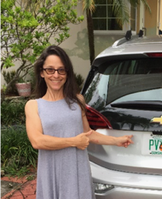
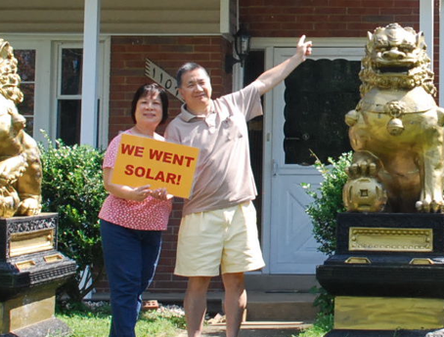
Non-profit organization:
Helps people join together
Go Solar
Fight for Energy rights
11 states Washington, DC and Puerto Rico
Notes:
Stress that we are a non-profit unaffiliated with any company or product that relies entirely upon community engagement and involvement
Brief overview of state program work
Objectives for Solar United Neighbors of STATE
Brief overview of national work
Organized 180 solar co-ops since founding in 2007
3,600 homes and business have gone solar through co-ops
Educated tens of thousands about solar
Almost 28 MW of installed capacity through solar co-ops

Slide 3
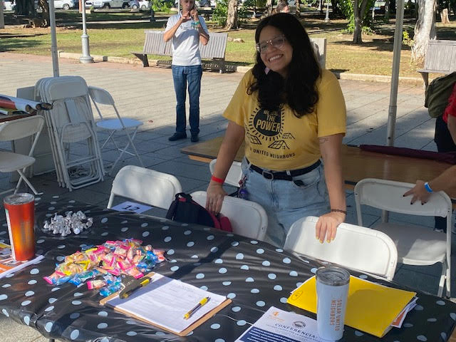
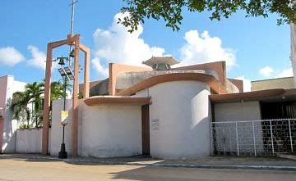
SUN's Work Success Stories in Puerto Rico
Go solar
Launched three solar co-ops:
University gardens 2020
Rio Piedras 2022
El Conquistador 2023
LMI CDBG MIT solar Vouchers
Resiliency Hubs proyects
Cataño Church project
Parroquia N.S. del Carmen
Centro Buen Pastor
Solar Village Project/
Planet Solar

Slide 4
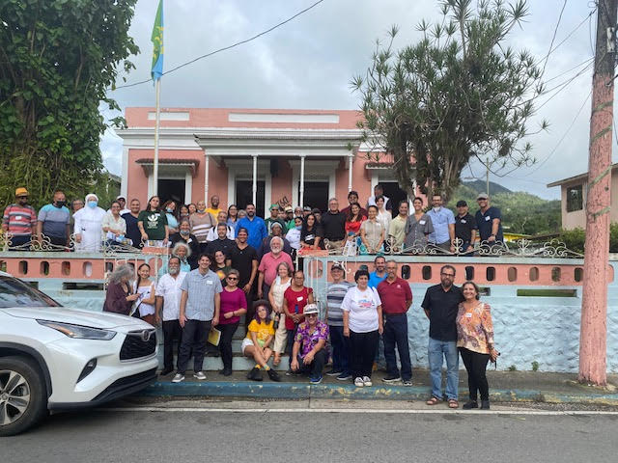
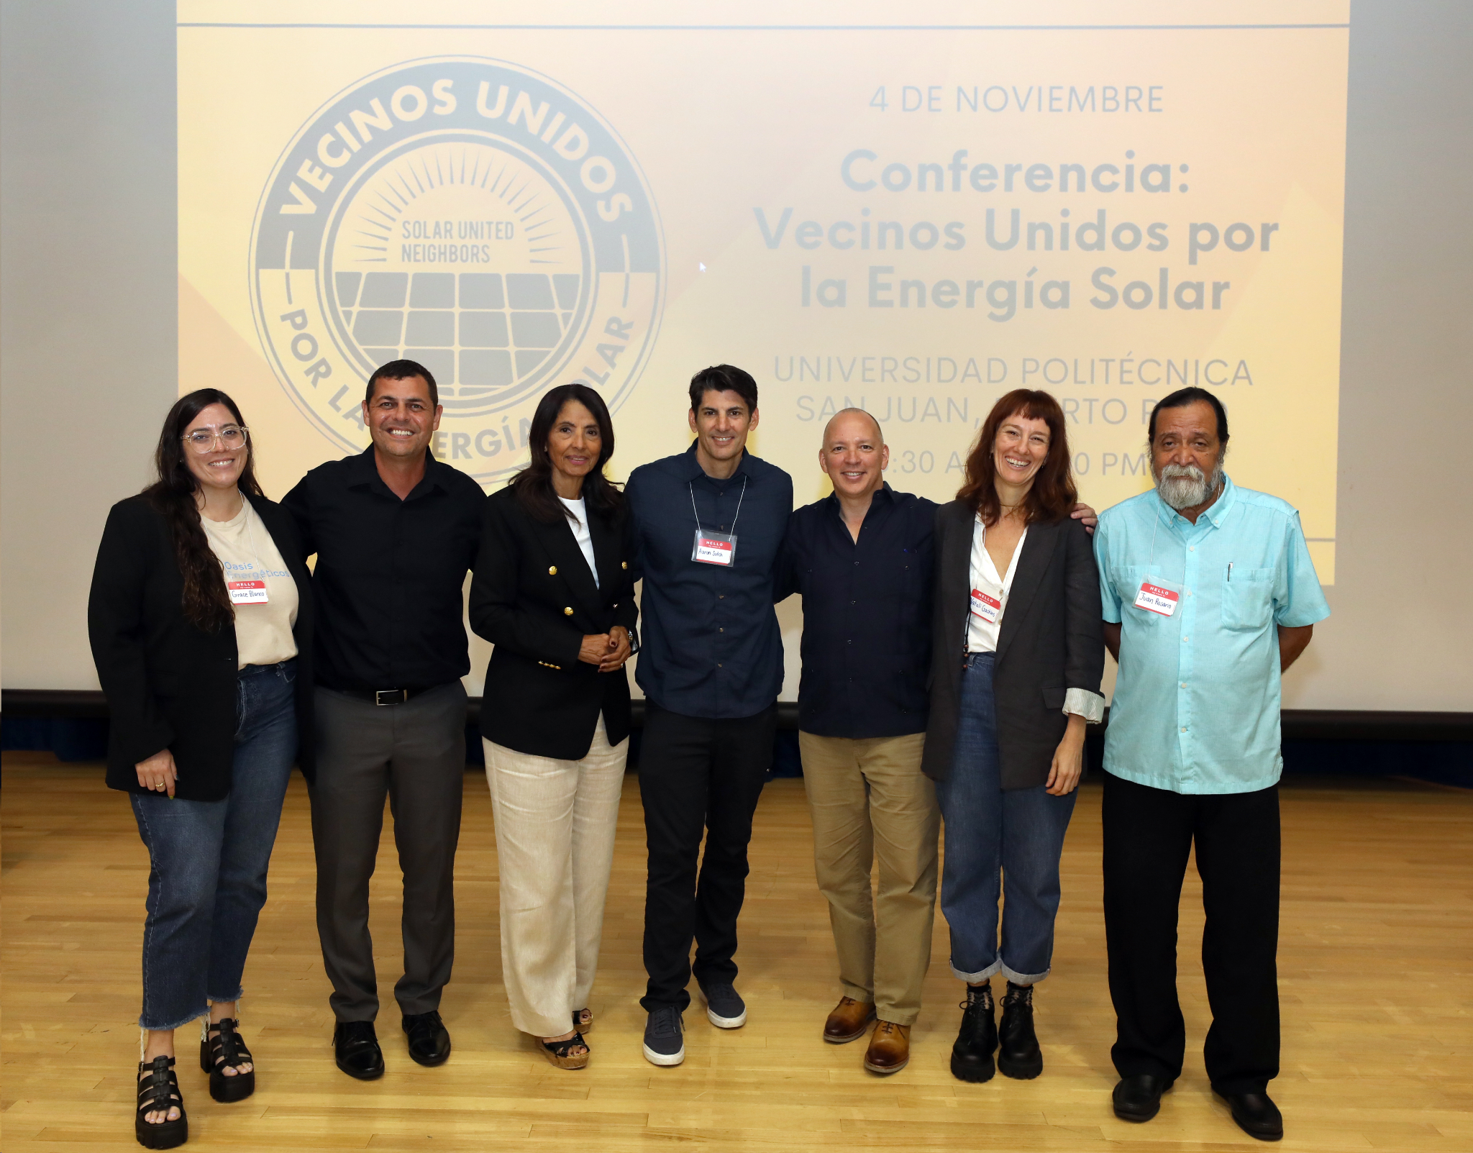
SUN's Work Success Stories in Puerto Rico Cont.
Join Together:
Encuentro Energético event 2023
Vecinos Unidos por
la Energía Solar event 2023
FL & PR meetings (connecting Diaspora)
Fight for Energy rights:
2022 SUN role in passing $1 Billion Dollar
DOE PR Energy Resilience Fund, part of an Omnibus bill
Microgrid grant in partnership with EarthSpark
/La Asociacion La Margarita/
La Margarita Abeyno Coop
Passed NEM extension bill P.S. 1064 on January 2024

Slide 5
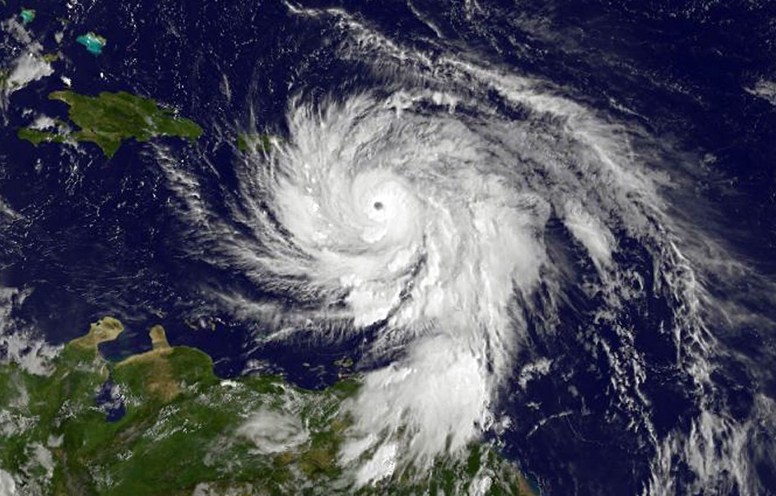
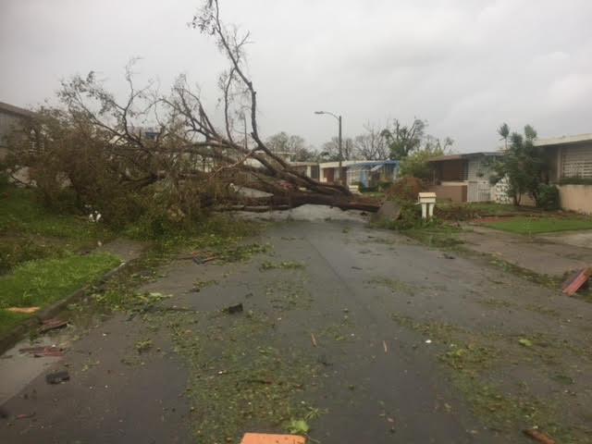
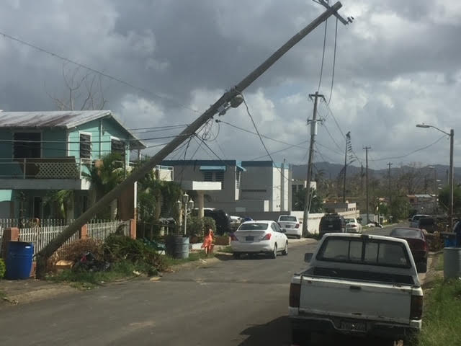
Hurricane Maria
Hurricane Irma and Maria impacts on the island:
Over 4,600 deaths
People left w/o electricity from 3 months – 1 year
People left w/o water 3 months – 6 months
Flooding devestated many towns and Municipalities
Many were left for months w/o access to food or drinking water
Over 90 billion dollars in damages

Slide 6
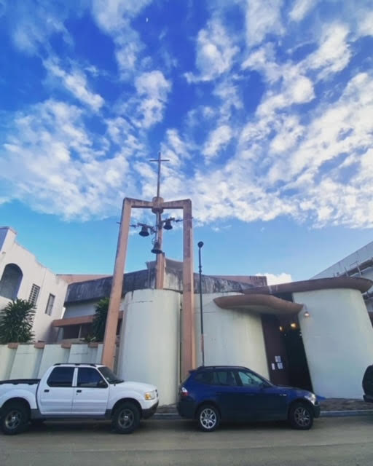
Nuestra Señora del Carmen Resiliency Hub
Nuestra Señora del Carmen located in Cataño, Puerto Rico:
Cataño was chosen because it’s a front-line community
Palo Seco and San Juan power plants
Evaluated several churches
Received $30,000 from an individual/Sun raised additional $33,000
Met with Church priest and sister
Project began in May of 2023 and took over 10 months to complete
The church received several proposals:
They later created a selection committee
Chose the installer with the best proposal and that served their needs

Slide 7
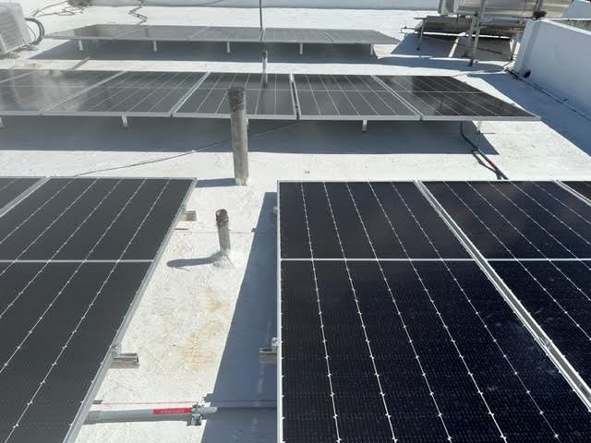
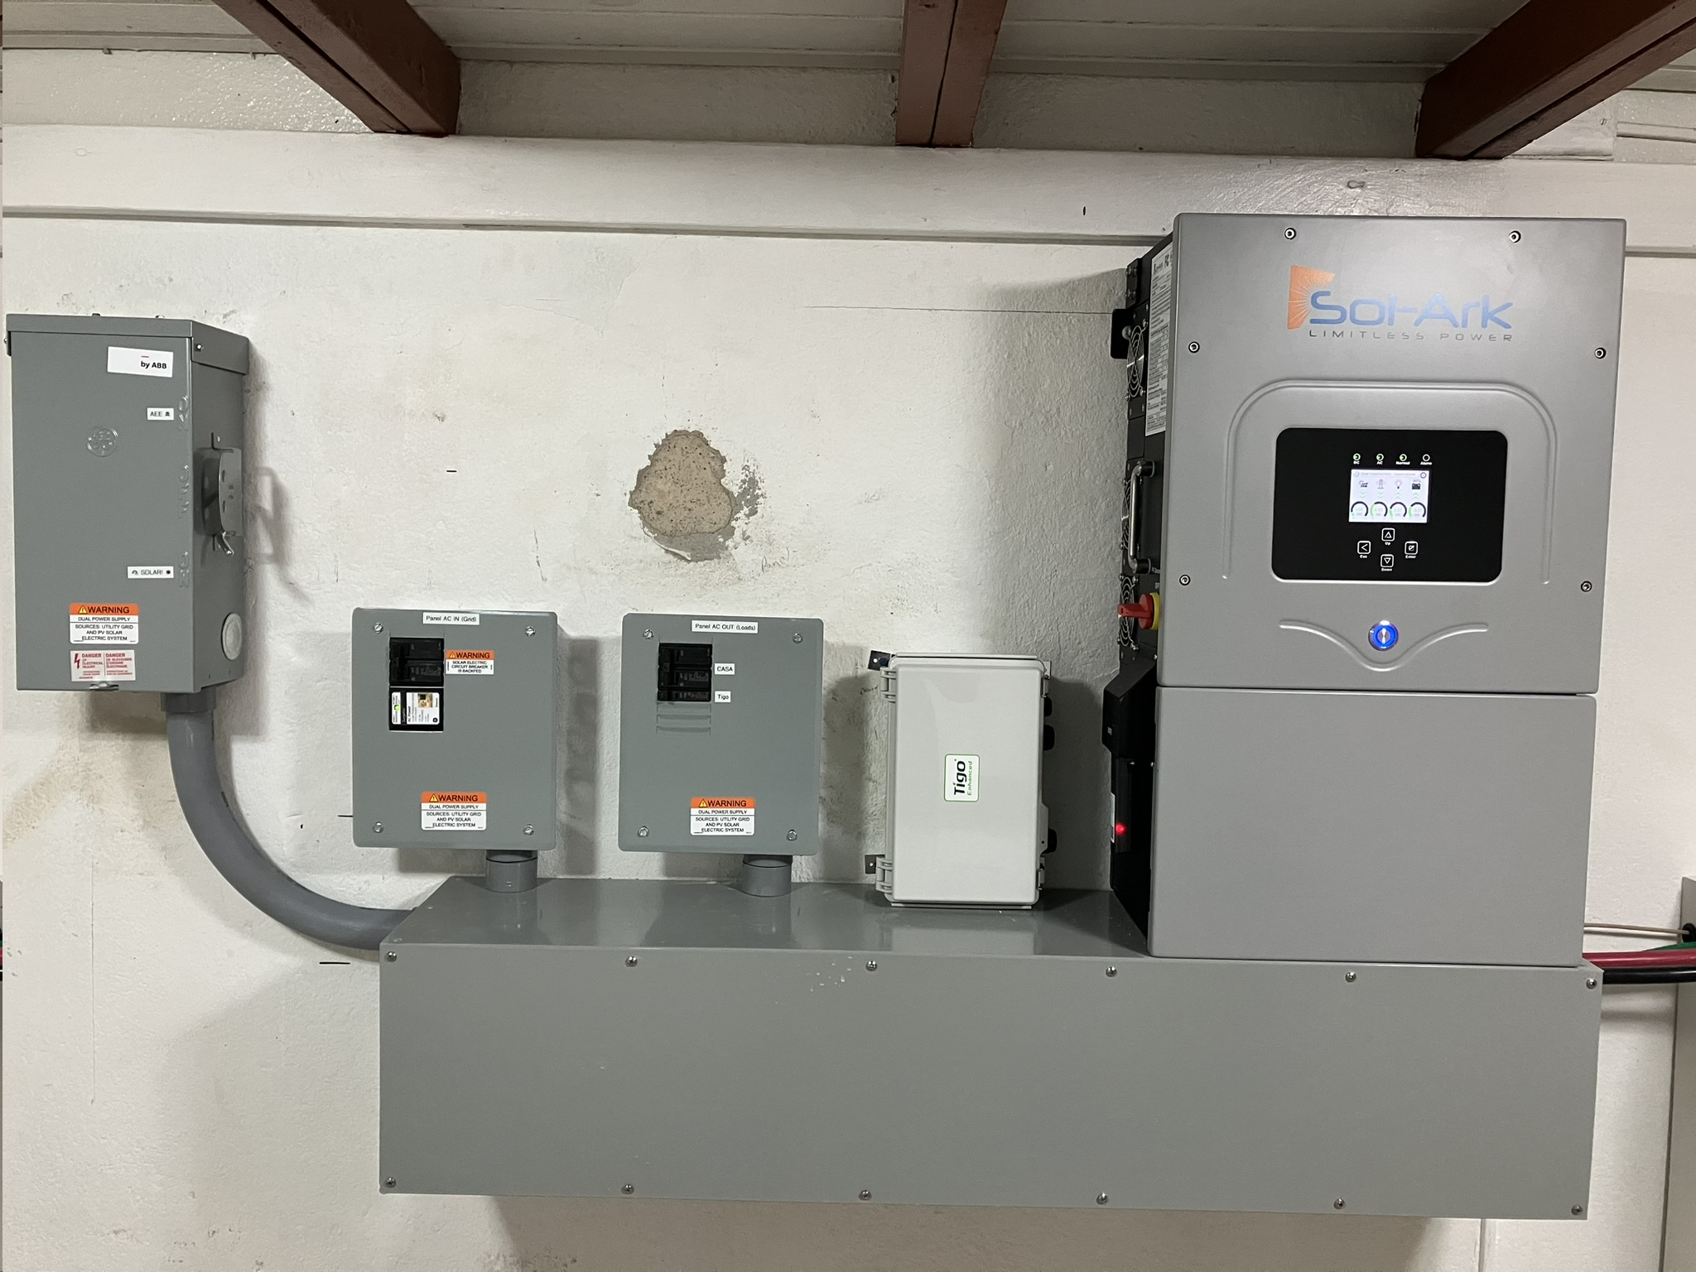
Nuestra Señora del Carmen Resiliency Hub Cont.
Resiliency Hub Goals
To become a resiliency hub for the municipality of Cataño that provides:
Become a primary shelter for those in need of medical equipment
Food and shelter during extreme weather events and natural disasters
Become a charging station
Provide refrigeration for medicine
Provide clean water
Become a hub for developing a larger resiliency strategy for the community

Slide 8
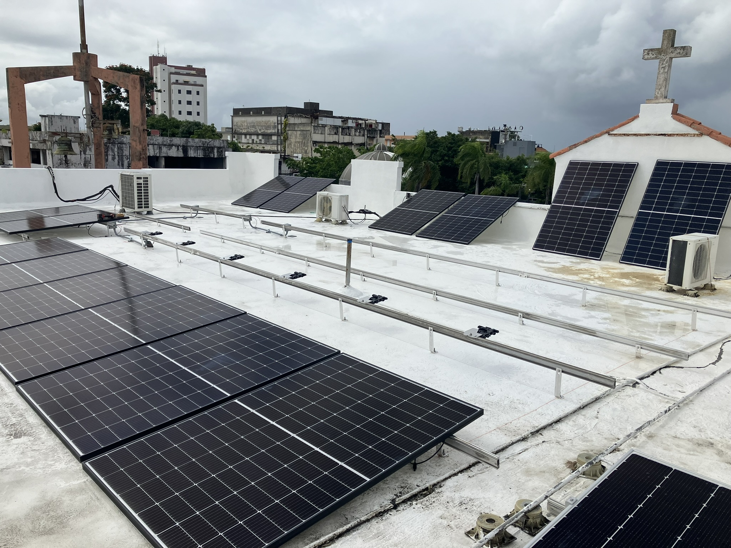
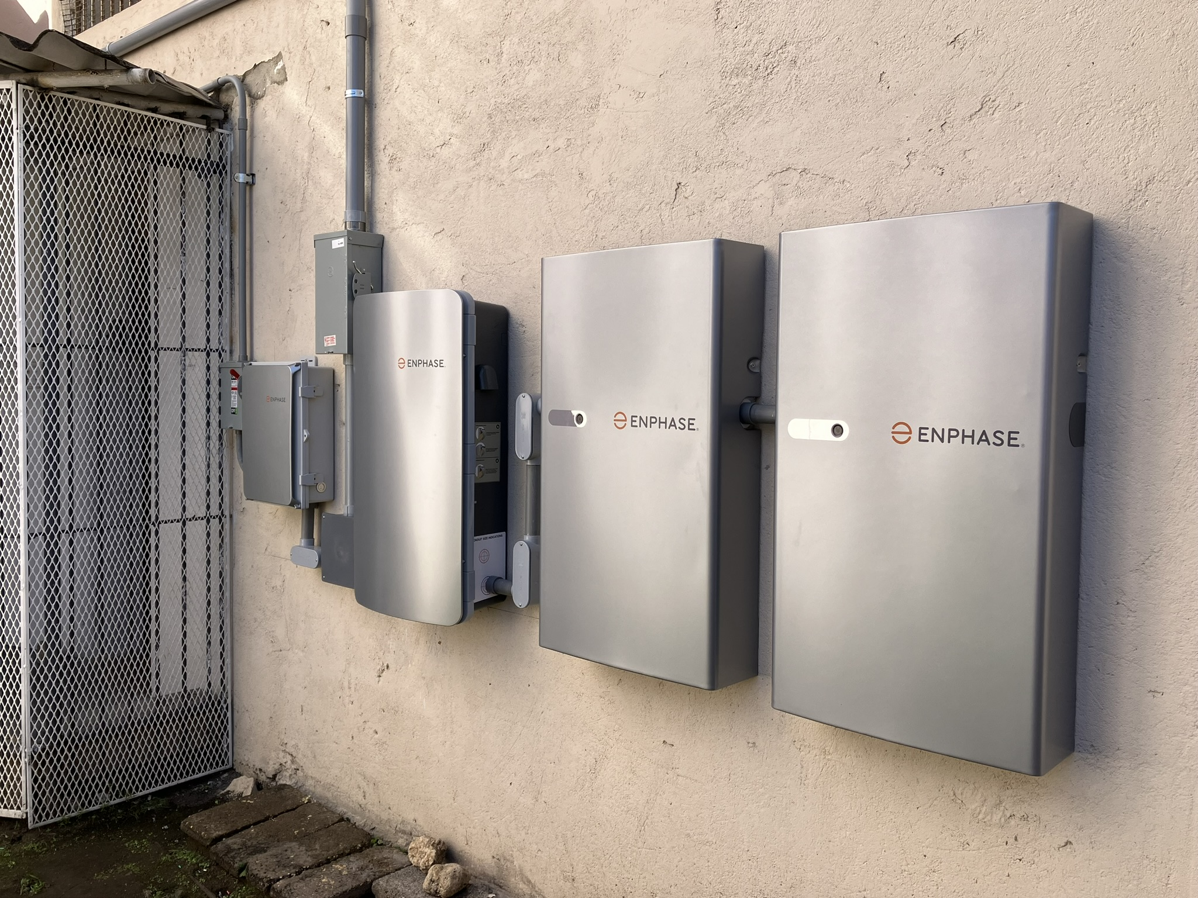
Nuestra Señora del Carmen Resiliency Hub Cont.
Resileincy Hub development approach
Meeting with the church community to identify threats and vulnarbilities
Discuss resourcess available
Identify all solar reouces in the community
Develop their Reciliency hub chart
Develop a plan with coordinated efforts
Include all available key stakeholders, agencies, individuals, essential businesses, and organizations
Publicly promote the program

Slide 9
Resiliency Hub as a Central Hub
Resiliency Hub
Individual Homes
School/Hospital
Essential Businesses
Gov./Agencies

Slide 10
¡Gracias!
David Ortiz
dortiz@solarunitedneighbors.org

